Slide 1
Module 2
ExtremeWare Overview
Notes:
This is the Module Title Page

Slide 2
Module Objectives
Describe briefly the Extreme Product family
Understand Extreme Architecture
Define the ExtremeWare Software
Describe ExtremeWare Features and Current Release versions
Summary
Notes:
Module Objectives are listed above.

Slide 3
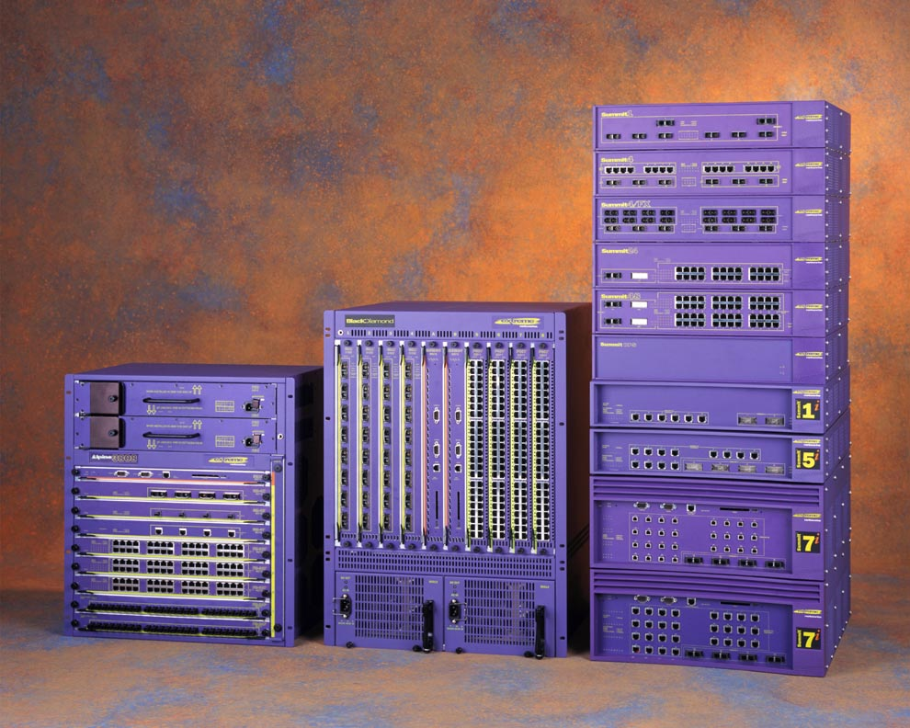
ExtremeWare Switch Family
Notes:
SLIDE PURPOSE: To give a brief view of Extreme Product Line
This is the entire product line as of August 31, 2000 is shown
Exception - Alpine 3404 is not shown
Alpine 3808
BlackDiamond 6808
(from top) Summit 1, Summit 4, Summit4/FX, Summit24, Summit48, SummitGbX, Summit 1i, Summit 5i, Summit 7i
ExtremeWare (EW)
ExtremeWare Enterprise Manager (EEM)
ExtremeWare ServiceWatch (ESW)

Slide 4
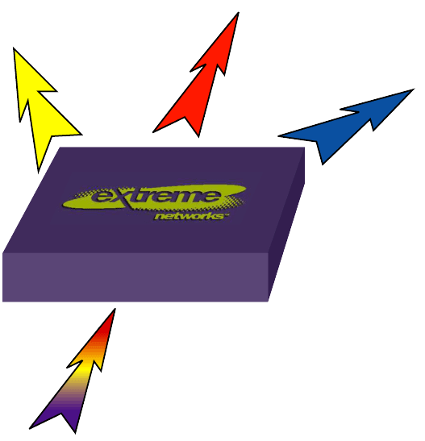



Extreme Architecture
Proprietary ASIC design & implementation of Core Technologies
The switch fabric is comprised of a collection of ASIC chipsets
Notes:
Focus is on the Extreme Architecture. This is based on a single ASIC chipset, comprised of several chips.
Wire-speed forwarding is made possible through Extreme’s proprietary ASIC (Application Specific Integrated Circuit) design and implementation of Core Technologies
Extreme develops their own ASICs internally. It is the core of Extreme products… entirely home grown, designed and manufactured. All products utilize Extreme’s software product called “ExtremeWare” which we will get entirely familiar with during the course of this class. The beauty of ExtremeWare is the cross-functionality of the Command Line Interface which makes information learned any product directly transferrable to any other. The commands are the same! (Syntax wise)
These chips are much more powerful than traditional methods used, as it can get deeper and deeper into gathering information other than getting just MAC address (such as going into Layer 3 IP information etc.) than traditional software based routers.
As we will talk about later, the forwarding of traffic is done within the hardware with lets us achieve true wire speed.

Slide 5
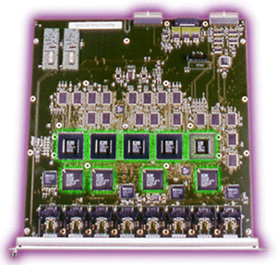
Consistent Architecture
Product Chipsets
  Summit chipset
  Summit “i” chipset
    Next Generation
ASICs
Notes:
Performance: It’s in the Chips
The unparalleled performance and consistent functionality across the entire family of Summit, Alpine and BlackDiamond switches are the result of the Summit chipset. With Extreme Networks switches, all processing that is required for forwarding packets at Layer 2 or Layer 3 is performed by these custom ASICs.
Full ASIC-based forwarding engines deliver more than 10-times higher throughput than routers that rely entirely on microprocessors. Like legacy routers, Extreme Networks switches use microprocessors to perform network management functions and to update route tables using standard protocols such as RIP v1, RIP v2, OSPF, DVMRP and PIM. However, processing route-table updates occurs outside the data path and therefore does not affect forwarding performance.
The Summit and Summit “i” architecture has been optimized for wire-speed routing of IP traffic and Layer 2 switching of all other protocol traffic. The Summit “i” chipset represents the next generation of switches from Extreme, which incorporate higher levels of integration and increased functionality at wire-speed. The Summit “i” chipset enables the development of switches with as much as four times the port density and performance.
One unique addition to the Summit “i” chipset is that wire-speed IPX packet forwarding is also performed. This optimization allows Summit, Alpine and BlackDiamond switches to take full advantage of high-performance custom silicon and a 64-byte-wide data path to perform wire-speed routing and switching with low latency.

Slide 6
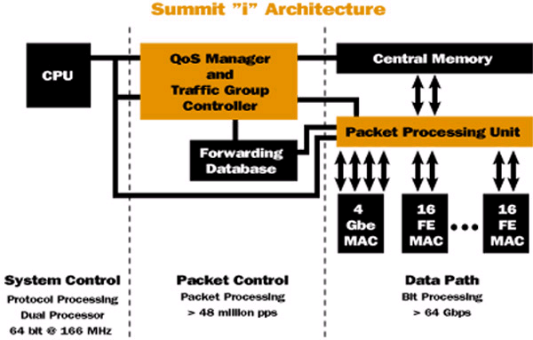
Summit “i” Architecture
Each Summit “i” MAC is capable of supporting 4 Gigabit or 16 Fast Ethernet interfaces at wire speed
Notes:
The Summit “i” chipset leverages the consistent architecture and feature set of the first-generation chipset, but with four times the density, twice the clock speed and half the power consumption per port.
In addition the QoS Manager and TCC are integrated.
Protocol Processing is increased with Dual Processors running 64 bit @ 166 MHz.
Point out that all Extreme products from stackables to chassis blades that end with an “i” are based on newer this newer ASIC.
“i” products REQUIRE ExtremeWare version 6.1 or higher
except BD and Summit 7i’s will run with EW 6.0

Slide 7
What is ExtremeWare?
Extreme’s full-featured software operating system
Designed to run on the BlackDiamond, Alpine and Summit family of Gigabit Ethernet switches
Current Software Version:
  For i-based switches : EW 6.1.8
  For non-i -based switches : EW 4.1.19
Notes:
Staying Current
For support purposes, we always recommend operating the most current release of ExtremeWare. If you are an Extreme Assist customer, the latest release and release notes are available through the support login portion of the Tech Support web site at http://www.extremenetworks.com/

Slide 8
ExtremeWare Management Software
EpiCenter
(EEM)
Browser-based
Vista
Command Line
Interface-(CLI)
RS-232, Telnet
HTTP
SNMP
Standard MIB & Extreme MIB

Slide 9
ExtremeWare Features
VLANs & support for IEEE 802.1Q & IEEE 802.1p
VLAN Aggregation
Spanning Tree Protocol (STP) (IEEE802.1D)
Policy-Based Quality of Service (PB-QoS)
Wire-Speed Internet Protocol (IP) routing
  Routing Protocols - RIP1 and RIP2, OSPF and BGP4
IP Multinetting
DHCP/BOOTP relay
Wire-speed IP multicast routing support
  IP Multicast routing protocols – IGMP, DVMRP, PIM-DM, PIM-SM
ESRP – Extreme Standby Routing Protocol

Slide 10
ExtremeWare Features cont.
Diffserv support
Access-policy support for routing protocols
Access list support for packet filtering
Wire-speed IPX, IPX/RIP, and IPX/SAP
SLB and WCR
Load sharing on multiple ports,
  across all blades (BD only)
RADIUS, TACACs and SSH2 connection
EW Vista Web-based management interface
Traffic mirroring for all ports,
  across all blades (BD only)
Notes:
Refer to the Release notes for ExtremeWare 4.1.X for details on new features added I.e.:
VLAN Aggregation
ESRP Tracking
1024 VLANs with the BlackDiamond
BlackDiamond FDB entries - 254 static entries
Free Layer 3 switching capabilities
RADIUS client
Configuration Logging

Slide 11
Summary
Describe briefly the Extreme Product family
Understand Extreme Architecture
Define the ExtremeWare Software
Describe ExtremeWare Features and Current Release versions
Notes:
Reference the latest ExtremeWare Software Release Notes to be up the date with current features.

Slide 12
This page is intentionally left blank.

